Slide 1
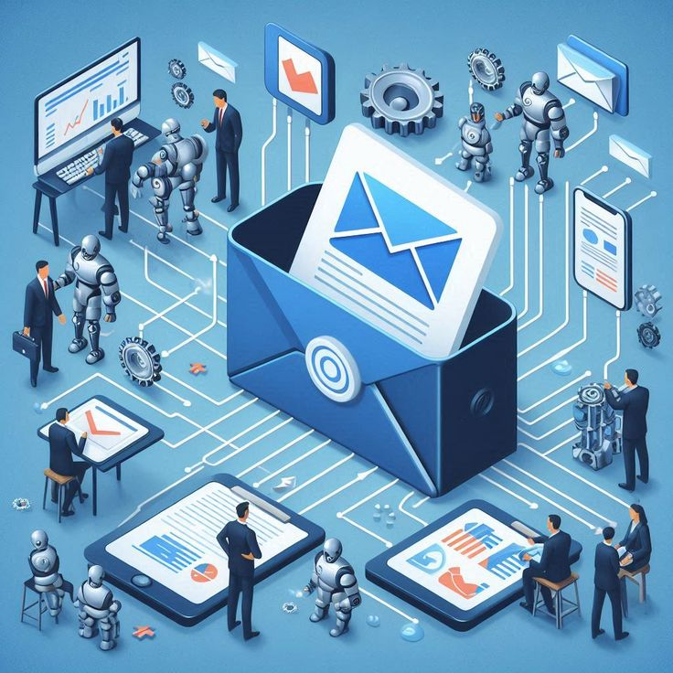





AI Powered Smart Email Classifier for Enterprises
Automating Inbox Intelligence with Machine Learning
Guided by: Mousami Shrivastava

Slide 2










The Problem & The Solution
The Problem
The Solution
Current Challenges
AI-Powered Triage
Information Overhead
Managing hundreds of thousands of emails manually is inefficient and costly
Automated Intelligence
AI model trained on over 204,000 historical emails
Delayed Response Times
Instant Categorization
Critical Complaints and support tickets get buried under general inquiries or spam
Emails evaluated in milliseconds and routed to correct department
Inconsistent Routing
Spam Elimination
Manual triage leads to human error, resulting in emails forwarded to wrong departments
Identifies and isolates unsolicited emails to keep queues clean
Interactive Application
Lack of Actionable Analytics
User-friendly dashboard for managers to monitor email traffic and model confidence
No real-time visibility into what customers are emailing about most frequently

Slide 3
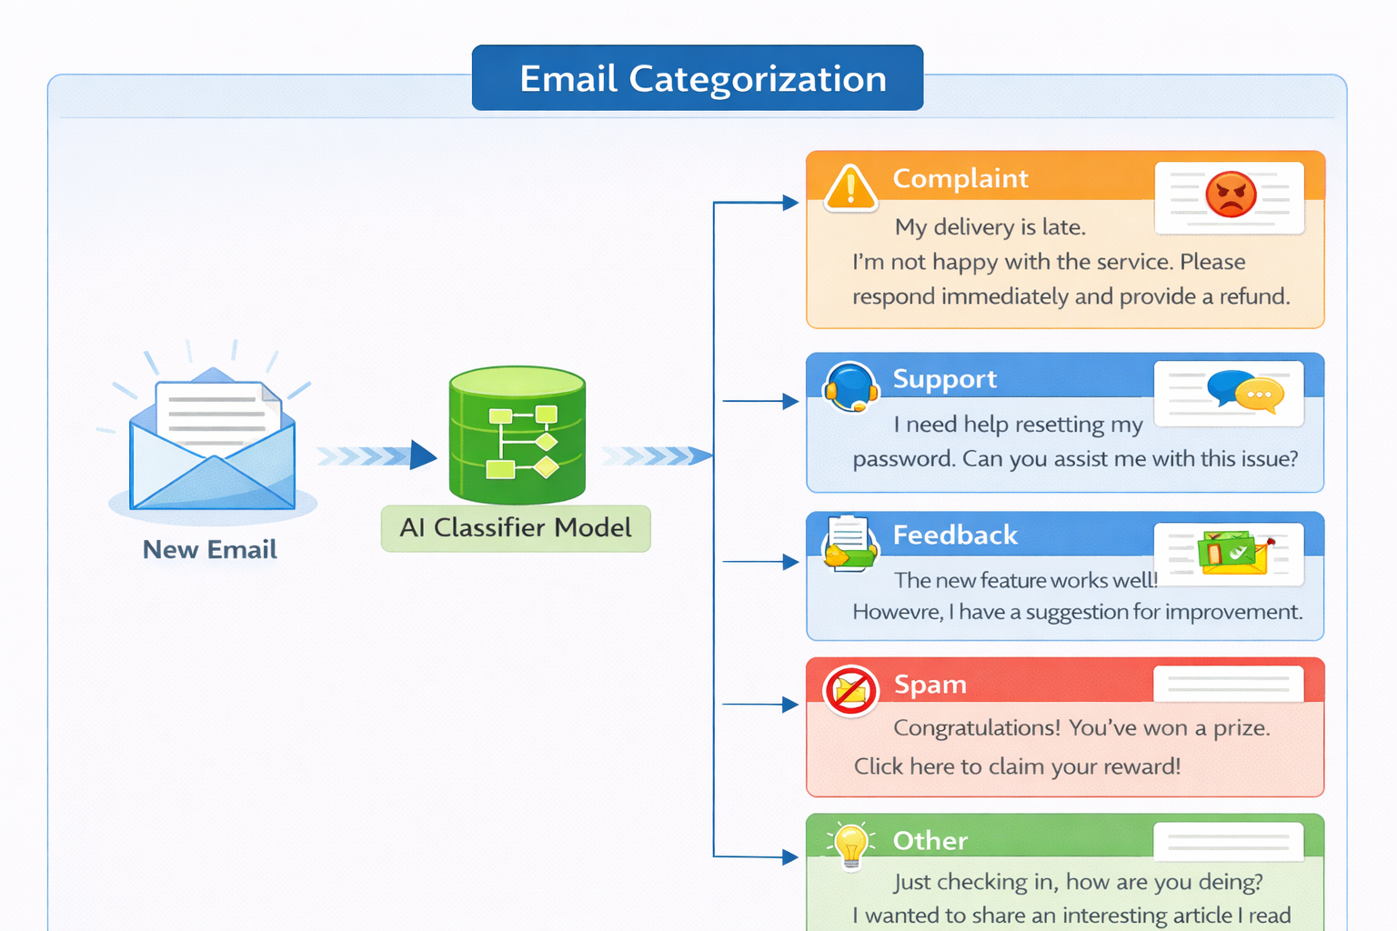
The 5 Core Categories & Actions
Complaint (High Priority)
Escalate immediately to customer service
Support (High Priority)
Route to technical teams
Feedback (Medium Priority)
Analyze for product improvements
Other (Low Priority)
Route to standard queue
Spam (Low Priority)
Auto-archive / Delete

Slide 4
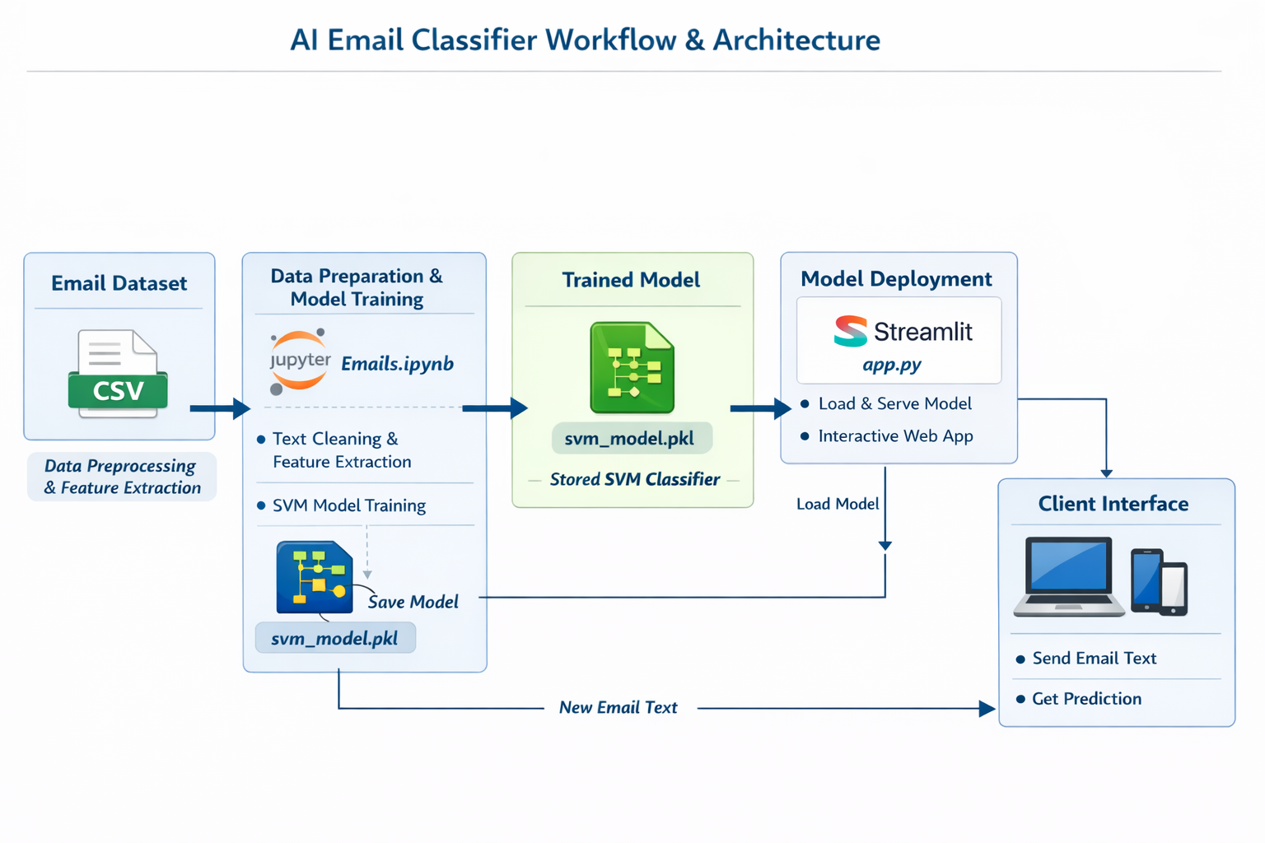





Overall System Architecture
Email Dataset (CSV)
Raw email data input source
Jupyter Notebook
Text cleaning and feature extraction
SVM Model Training
Optimization and classification learning
Model Storage
Saved as svm_model.pkl
Streamlit Deployment
Interactive web app for predictions

Slide 5








The AI Engine & Business Value
The AI Engine - Under the Hood
Model Architecture
Massive Training Dataset
Linear SVM with TF-IDF vectorization
Perfectly balanced dataset
8,000 features with 3-word combinations
204,000 emails trained and evaluated
Industry-Leading Accuracy
Flawless Precision
Overall classification performance
Support and Spam categories
99.22% accuracy achieved
Perfect 100% F1-score
Business Value & ROI
Massive Time Savings
Improved SLAs
Eliminates thousands of hours of manual triage per year
Faster response times for critical support and angry customers
Data-Driven Insights
Cost Efficiency
Direct insight into customer feedback trends for marketing and product teams
Lightweight deployment structure using Python and Streamlit

Slide 6






Interactive Analytics Dashboard
Real-time Metrics
Deep-Dive Analytics
Volume Tracking
Analyzes most influential keywords across categories
12,458
Total Emails Today
Complaint: delay, late, issue
1,892
30-Day Interactive Charts
Spam Blocked
Support: reset, password, login
Daily email volume trends and category distribution visualization
Feedback: great, suggestion, improve
96.8%
Average Confidence

Slide 7


API Integration & Deployment Roadmap
Current State
Future Scope
Live & Deployed
Enterprise API Integration
99.22% accuracy achieved
FastAPI model exposure
Streamlit app fully built
Live email server connection
Ready for immediate use
Silent automated background routing
Real-time analytics dashboard
Direct Outlook/Gmail integration
Interactive testing interface
Zero human intervention required

Slide 8

Thank You
Questions? Let's Discuss.

